Slide 1
Innovator’s toolkit
Paweł Krzyworzeka
pkrzyworzeka@kozminski.edu.pl

Slide 3
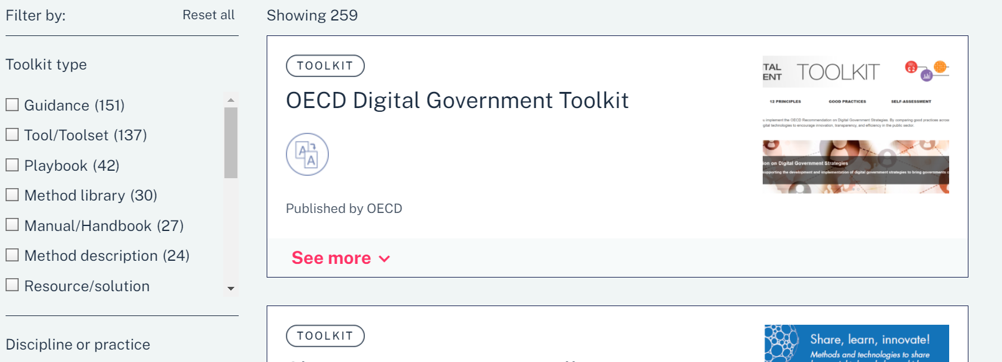

Slide 4
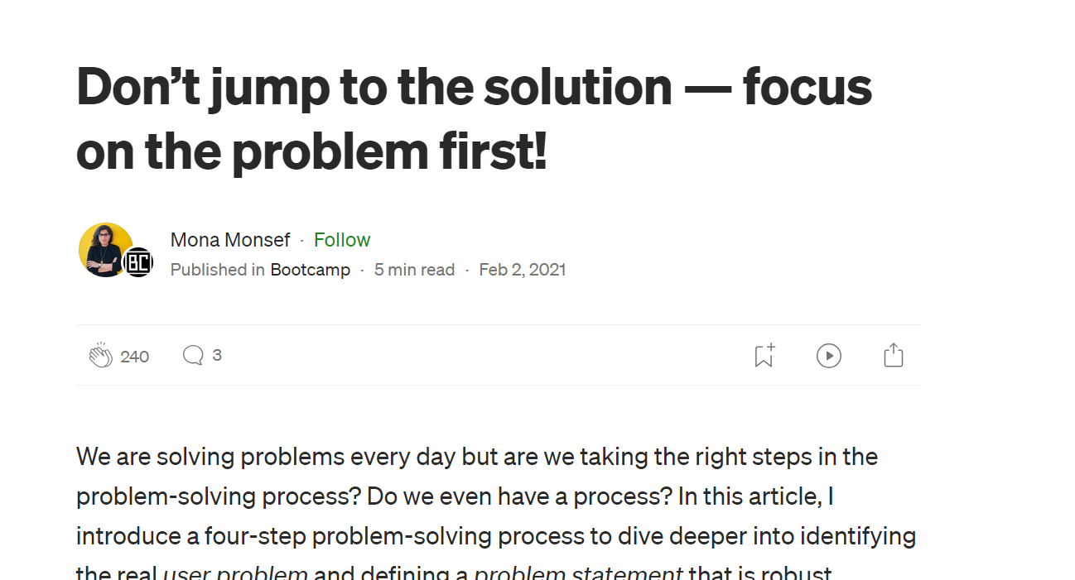
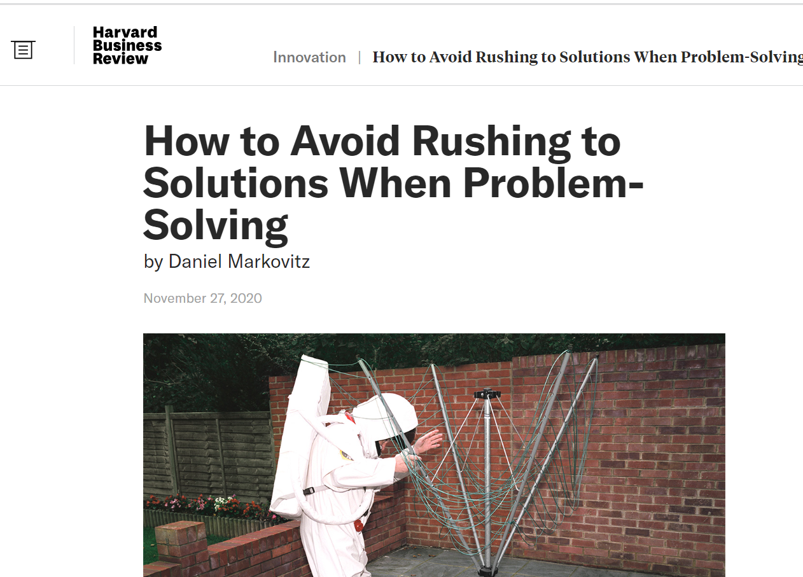
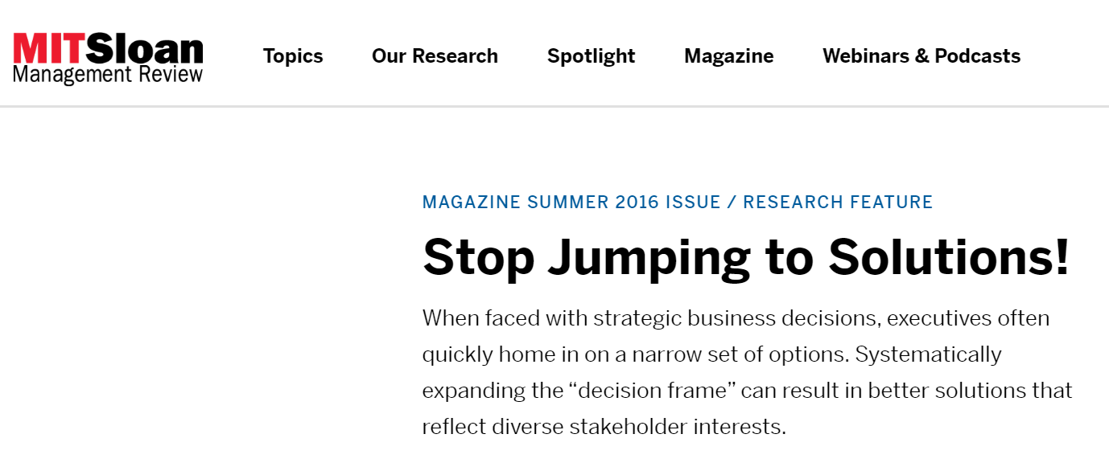
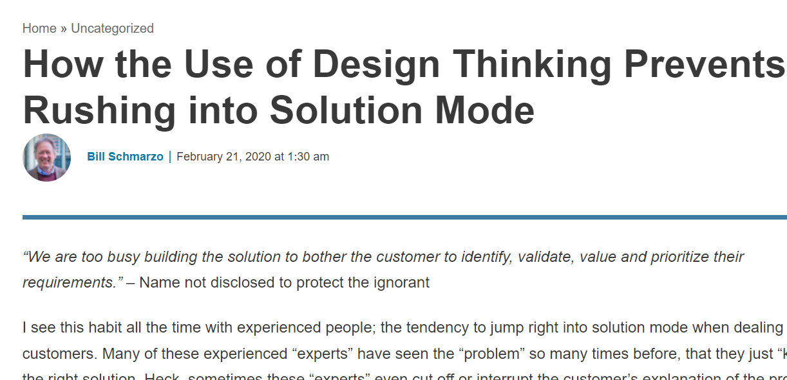
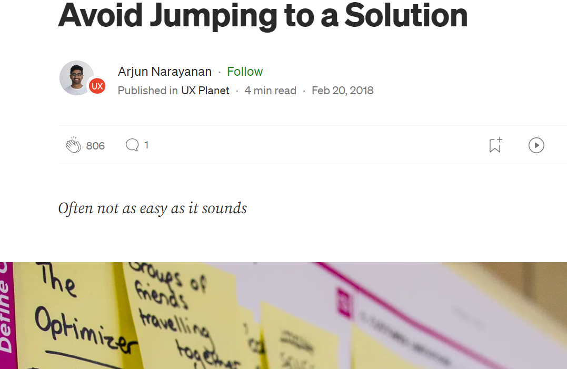
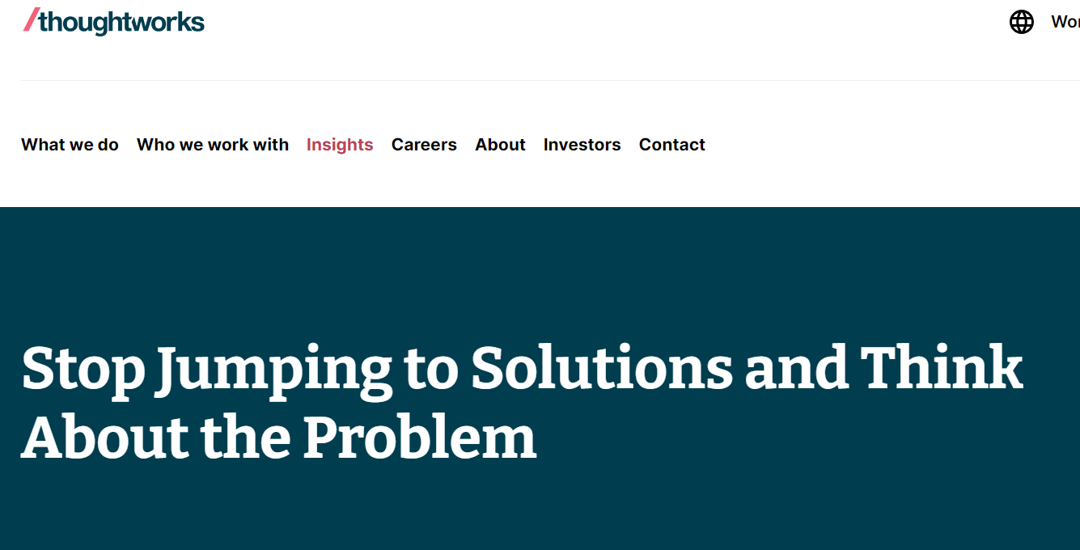
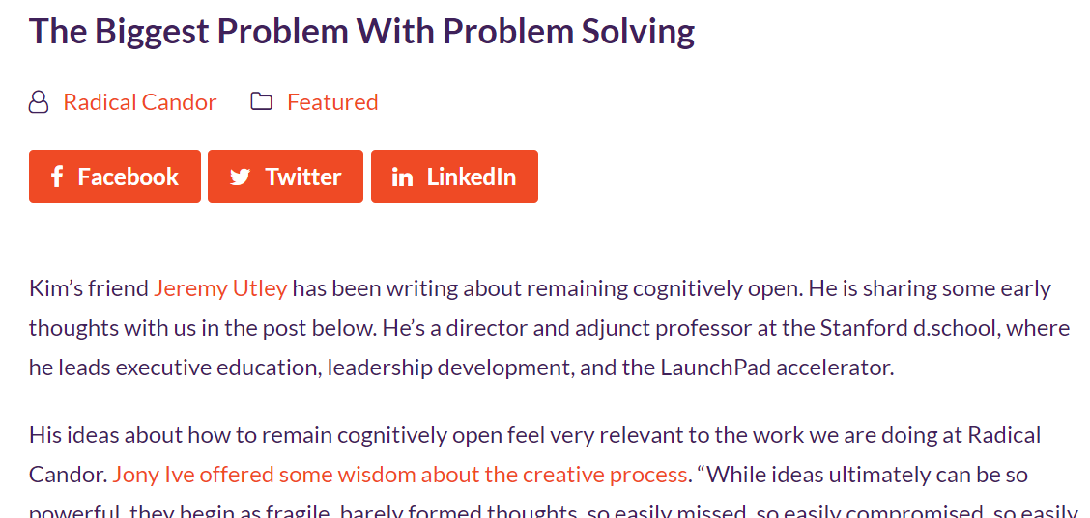

Slide 5
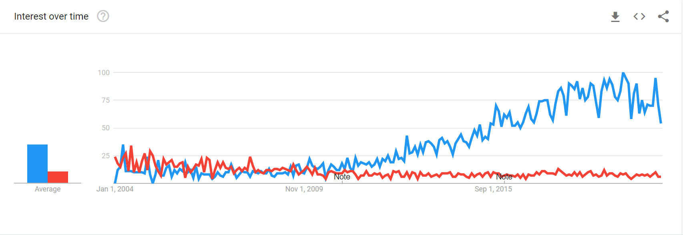

Slide 6
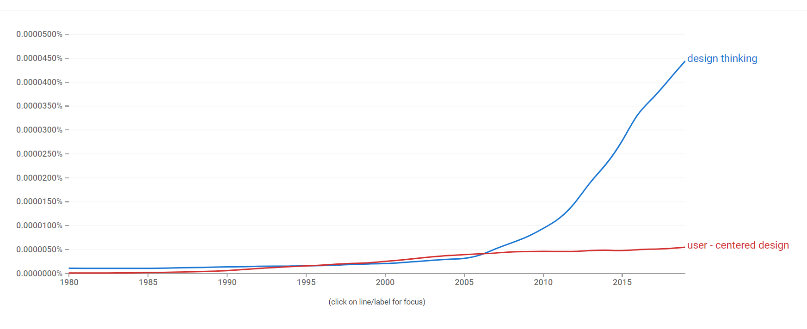

Slide 7
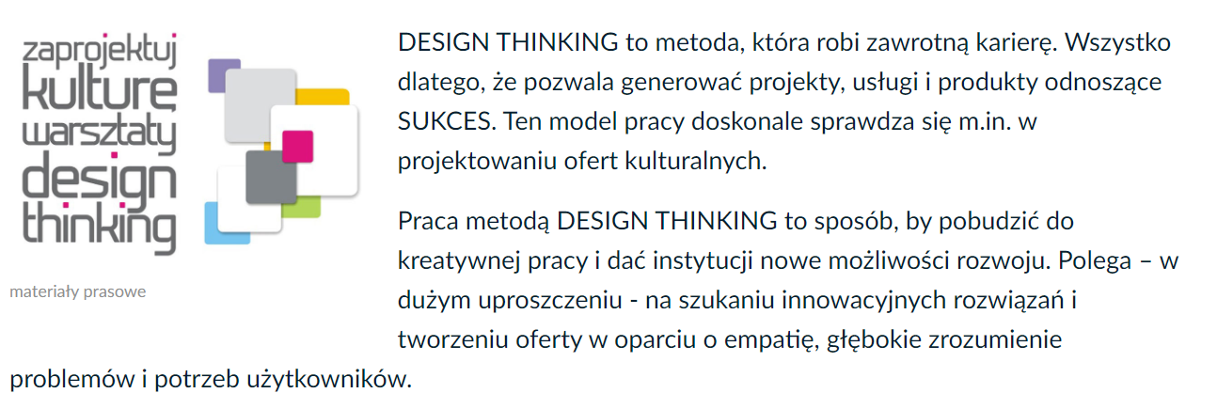
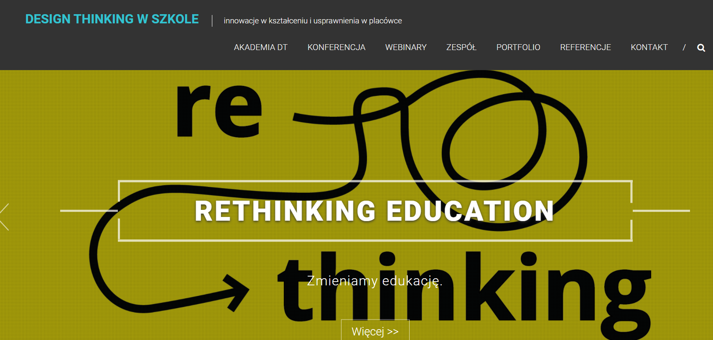

Slide 8
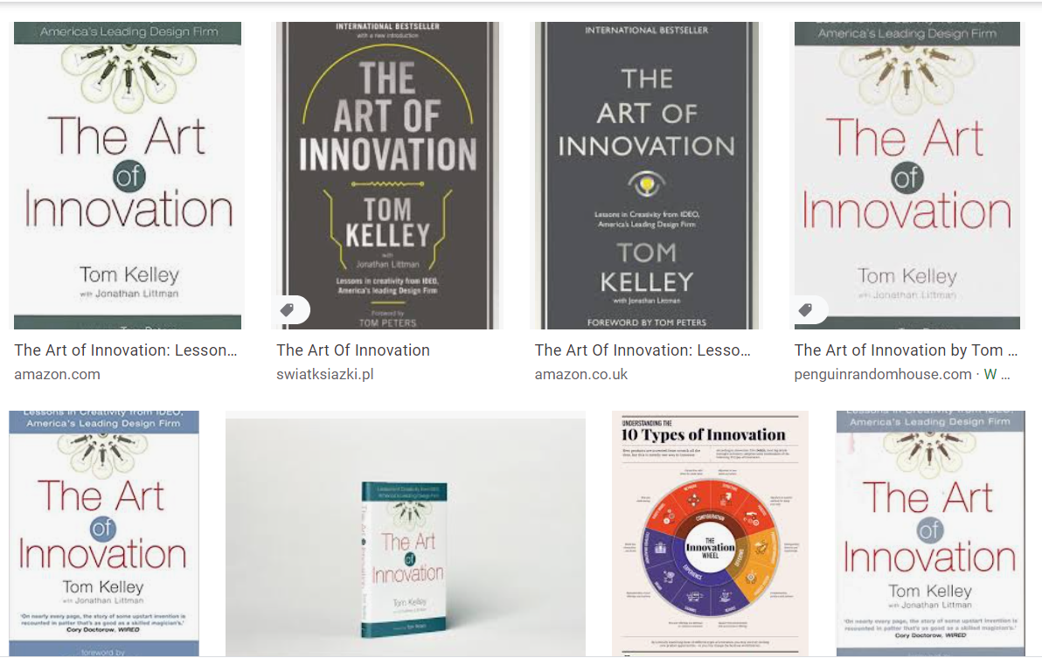

Slide 10
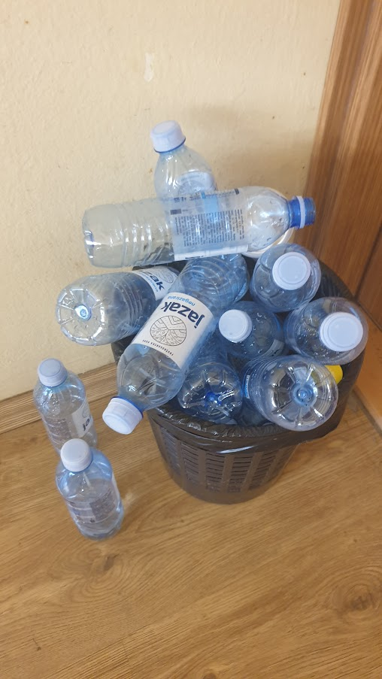

Slide 11
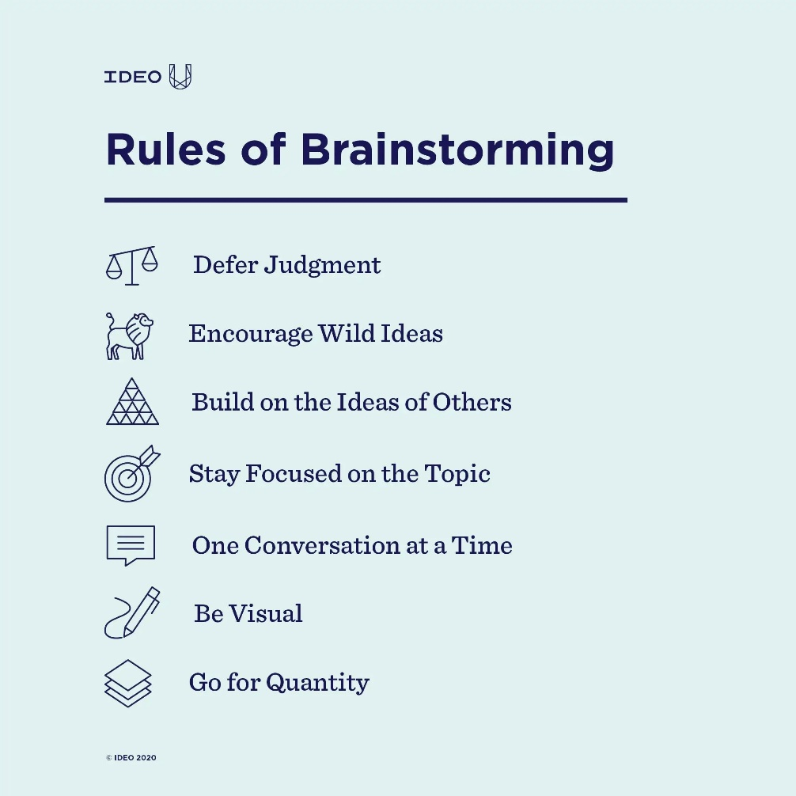

Slide 12
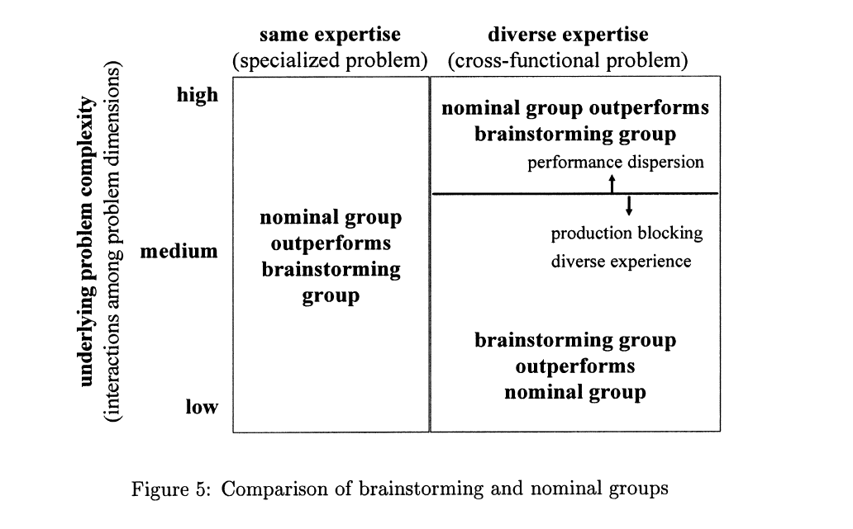
Notes:
Kavadias, Stylianos, and Svenja C. Sommer. 2009. ‘The Effects of Problem Structure and Team Diversity on Brainstorming Effectiveness’. Management Science 55 (12): 1899–1913.

Slide 13
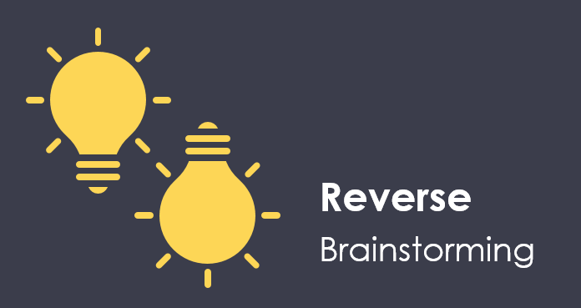
Instead of asking, "How do I solve or prevent this problem?"
ask, "How could I possibly cause the problem?"
instead of asking "How do I achieve these results?"
ask, "How could I possibly achieve the opposite effect?"

Slide 14
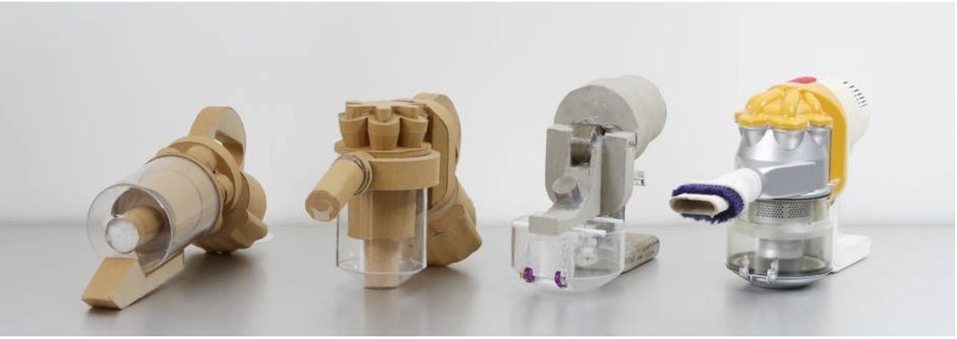
Proto typing
A likeness to a particular
character or nature…
Prefix, meaning original or primitive
From the Greek word Prōtos ‘first’
Notes:
PROTOTYPING, Dr Ollie Hemstock & Dr Nick Spencer, Northumbria University School of Design [unpublished presention]

Slide 15
Prototype early and often
reduce uncertainties
increase feasibility
engage with users
essential part of new product development
Notes:
PROTOTYPING, Dr Ollie Hemstock & Dr Nick Spencer, Northumbria University School of Design [unpublished presention]

Slide 16
Some assumptions to challenge
“Prototyping happens once you have got the design mostly figured out…”
“Prototypes should look and function like the final design…”
“Prototypes are always expressions of physical products…”
Prototyping can happen at any point in the design process. Better understanding earlier in the process allows for more effective ideas
A prototype can be used to learn about any aspect of the design. It can be something that doesn’t even appear in the final design.
Any medium can be used to create a prototype. A prototype can be a tangible artefact of any kind.
Notes:
PROTOTYPING, Dr Ollie Hemstock & Dr Nick Spencer, Northumbria University School of Design [unpublished presention]

Slide 17
Prototyping PURPOSE
Notes:
PROTOTYPING, Dr Ollie Hemstock & Dr Nick Spencer, Northumbria University School of Design [unpublished presention]

Slide 18
Lo-fi Prototyping
„low fidelity”
Fidelity refers to how well resolved or complete a thing is; how faithful an expression is to its intent.
Simply put, low fidelity means you are less concerned with giving an accurate representation of the finished design.
What is more important is expressing a particular aspect of the design’s intention in a tangible and interactive way…
Notes:
PROTOTYPING, Dr Ollie Hemstock & Dr Nick Spencer, Northumbria University School of Design [unpublished presention]

Slide 19
Being creative and having a good idea is not enough to succeed. Do you are with the statement?

Slide 20
Invention vs Innovation
The beaver told the rabbit as they stared at the Hoover Dam: No, I didn't build it myself, but it's based on an idea of mine
- widely ascribed to Charles H. Townes; inventor of a laser

Slide 21
available|affordable| reliable
Invention becomes innovation when it becomes accessible
Notes:
A do tego trzeba dużo wysiłku, pracy i kreatywności całego zespołu.

Slide 22
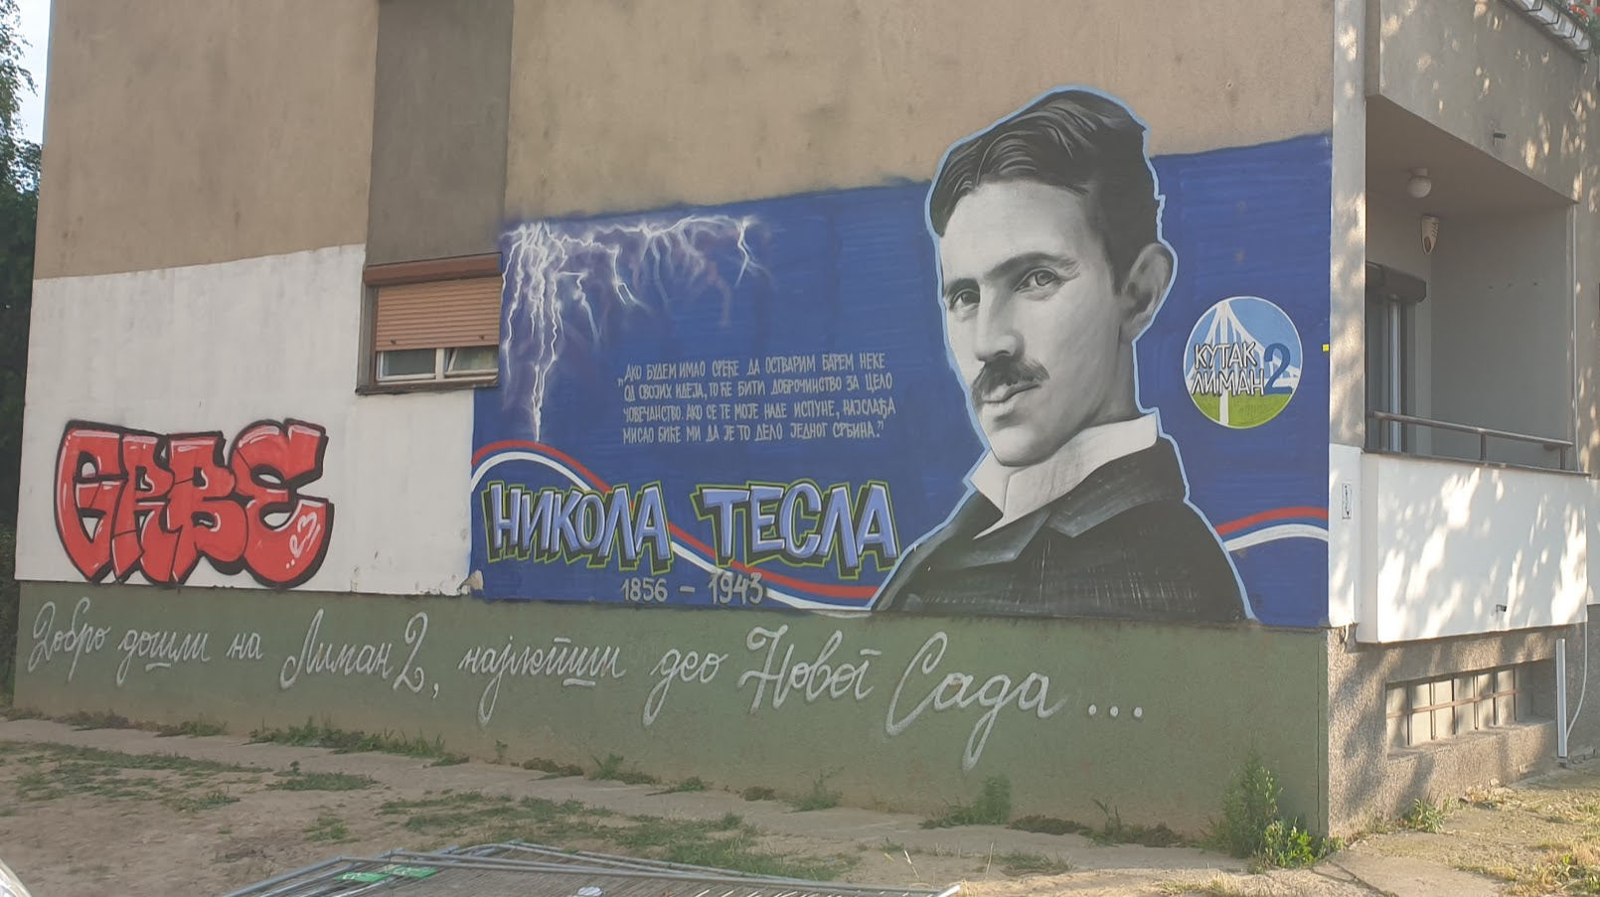

Slide 23
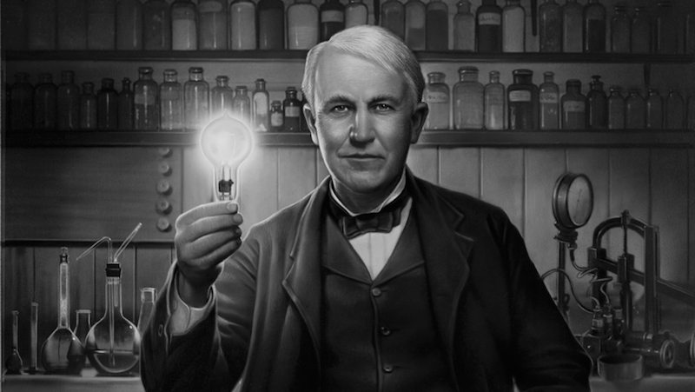
Did Thomas Edison invent the lightbulb?
https://gohighbrow.com/light-bulb/

Slide 24
Around the same time, 21 individuals, independently, in different parts of the world, made a similar discovery and developed the light bulb.
Ridley, Matt. How Innovation Works: And Why It Flourishes in Freedom. Place of publication not identified: Harper, 2020.
Notes:
Ale my znamy tylko Edisona

Slide 25
available|affordable| reliable
Invention becomes innovation when it becomes accessible
Notes:
A do tego trzeba dużo wysiłku, pracy i kreatywności całego zespołu.

Slide 26
search for "examples of social innovations." Take a look at the image search results. What can you observe regarding the colors and overall atmosphere?

Slide 27
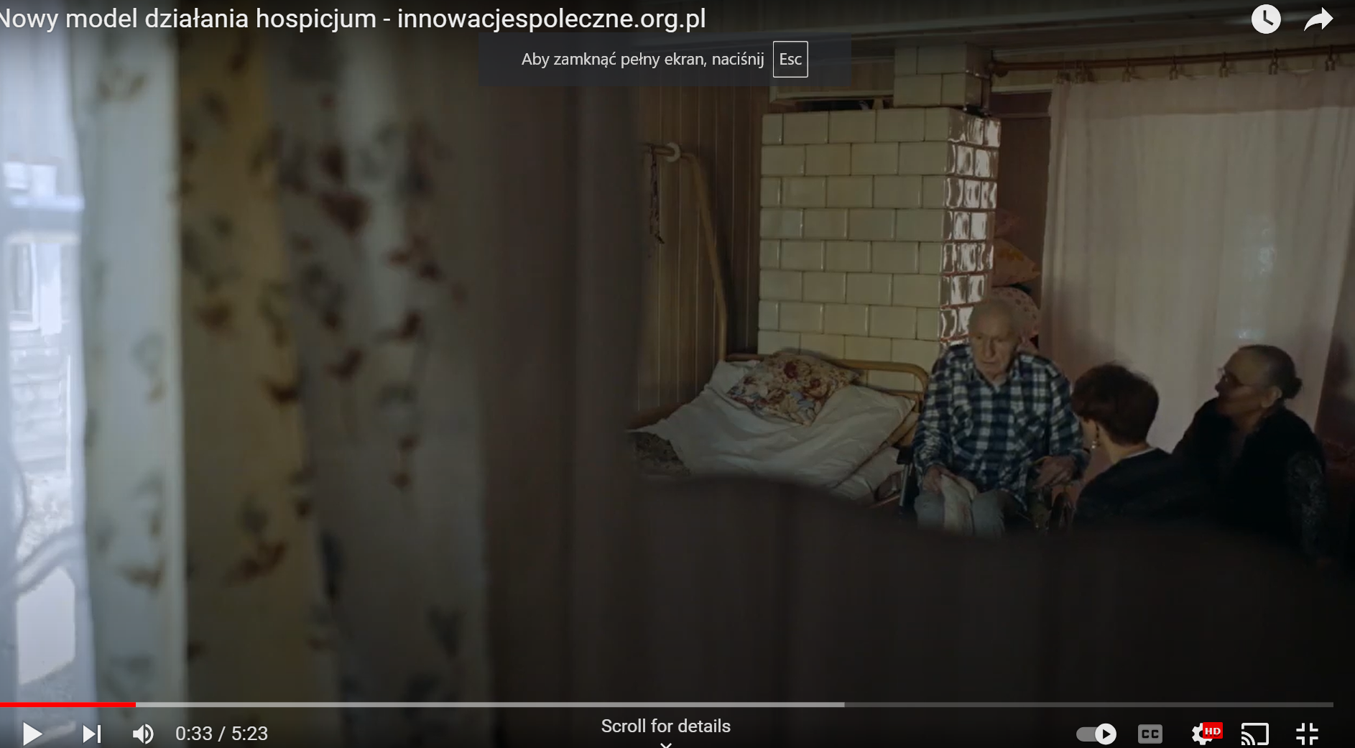
Notes:
https://www.youtube.com/watch?v=kqiGPh5mVTg&t=208s

Slide 28
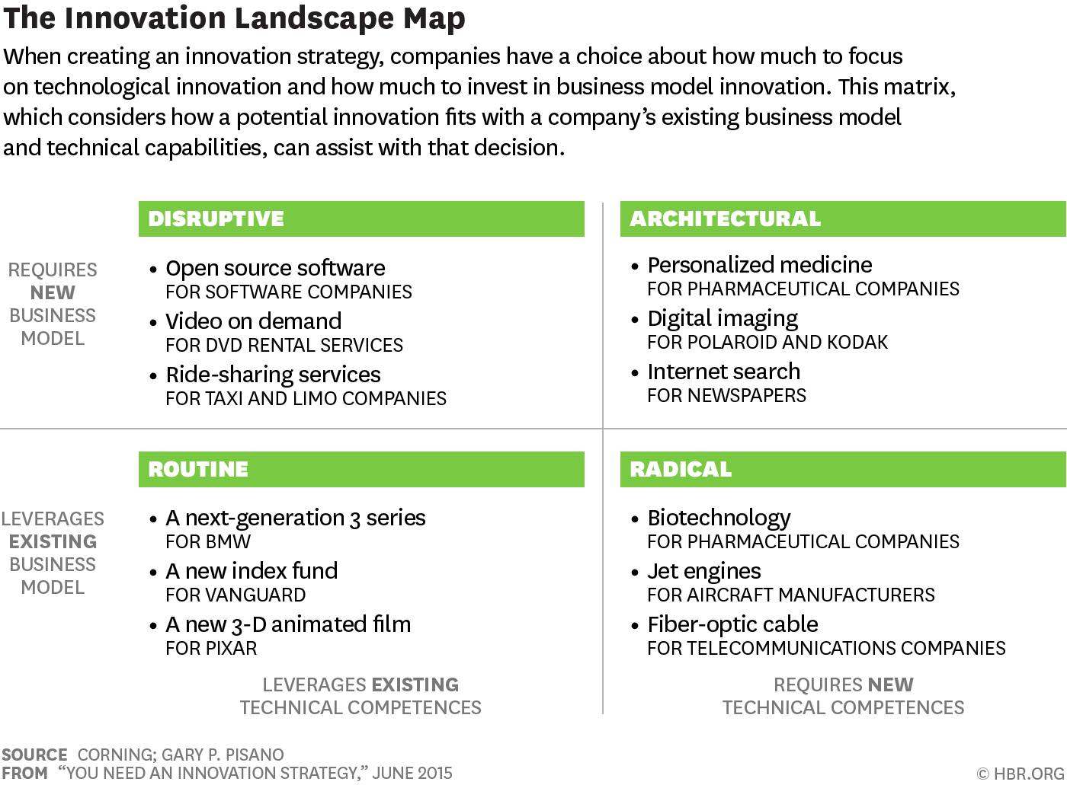
Notes:
Rutynowe
Intel’s launching ever-more-powerful microprocessors
icrosoft Windows and the Apple iPhone.
Disruptive (przełomowe)
Google’s Android operating system for mobile devices potentially disrupts companies like Apple and Microsoft, not because of any large technical difference but because of its business model
Radical innovation (radykalne)
Czysto technologiczna
rugs derived from biotechnology were a good fit with the companies’ business models, which called for heavy investment in R&D, funded by a few high-margin products.
Architectural innovation (architektoniczne)
combines technological and business model disruptions. An example is digital photography. For companies such as Kodak and Polaroid, entering the digital world meant mastering completely new competences in solid-state electronics, camera design, software, and display technology. It also meant finding a way to earn profits from cameras rather than from “disposables”

Slide 30
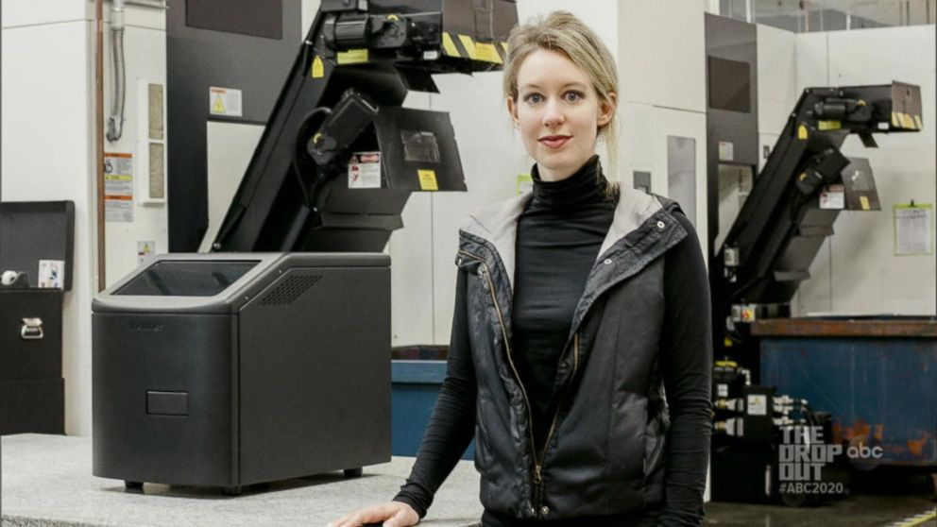
Theranos - a revolutionary way to test blood
128 different tests in 15 minutes,
based on a single finger prick
Value of the company $9 billion
Raised $400 million from investors

Slide 31
https://www.youtube.com/watch?v=UiNFXcI9Rb8

Slide 32
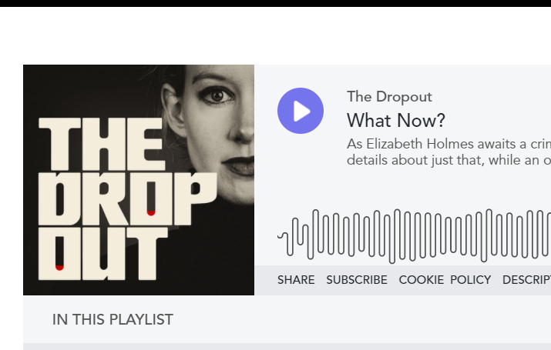

Slide 33
https://www.youtube.com/watch?v=wtDaP18OGfw

