Slide 1
Social Hackathon: Changing Society Through Inclusive Education
Cost Action 18236
Triin Kübar (Estonia)
Denada Lica (Albania)
Milena Mitrović (Montenegro)
Miloš Lazarević (Serbia)
05. July 2023

Slide 2
5xW & H
What is the challenge?
Children with special needs are not included in PE lessons and later in the job market (Sakotic et al., 2008; Djevic, 2015; Shields, & Synnot, 2016; Radojlovic et al., 2019)
Who are we addressing?
Teachers, local communities, employers and society as a whole
Why are we doing this?
Including special needs children in PE is good for their wellbeing
To create more inclusive and fair society

Slide 3
5xW & H
When is this going to happen?
February 2024
Where?
2 case study schools in each project country
How are we going to achieve this?
Research and developing new methodologies and training materials
Community consultations and round tables
Train the trainers and teachers

Slide 6
References
Radojlovic, J., Simovic, T., & Nedovic, G. (2019). Poredjenje stavova dece tipicnog razvoja prema deci sa smetnjama u razvoju u 2012. i 2017. godini. Engrami, 41(2), 6-16.
Djevic, r. (2015). Socijalna interakcija ucenika sa smetnjama u razvoju u osnovnoj skoli (phd dissertation). University of Belgrade: Faculty of Philosophy.
Sakotic, n., Eminovic, F., & Nikic, R. (2008). Possibility education in inclusion of children with special needs. Specijalna edukacija i rehabilitacija, 1-2, 55-71.
Shields, n., & Synnot, A. (2016). Perceived barriers and facilitators to participation in physical activity for children with disability: a qualitative sudy. BMC pediatrics, 16(1), 1-10.

Slide 7
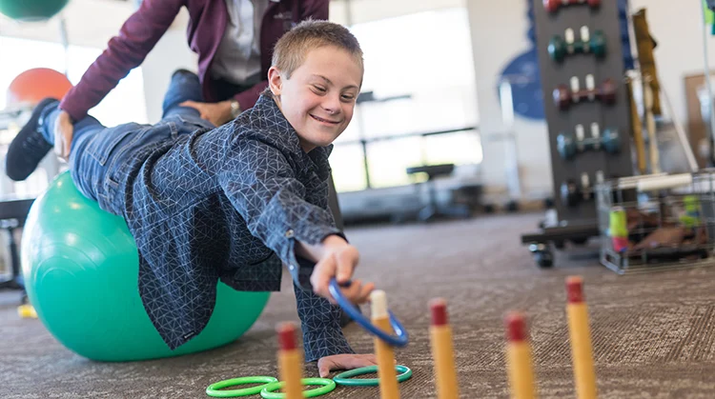
Thank you!

