Slide 1
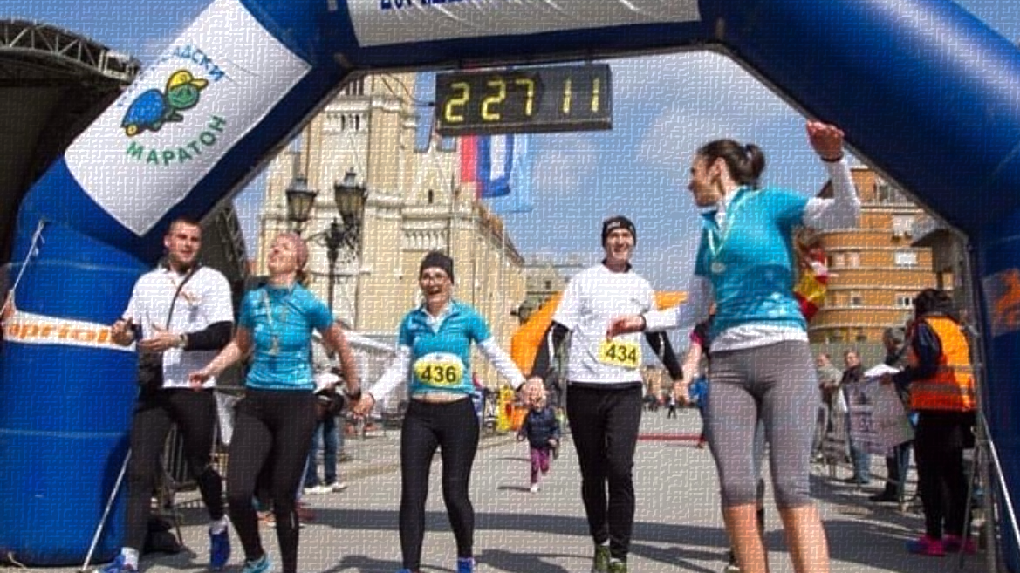
Shining moments
A race where everybody is involved

Slide 2
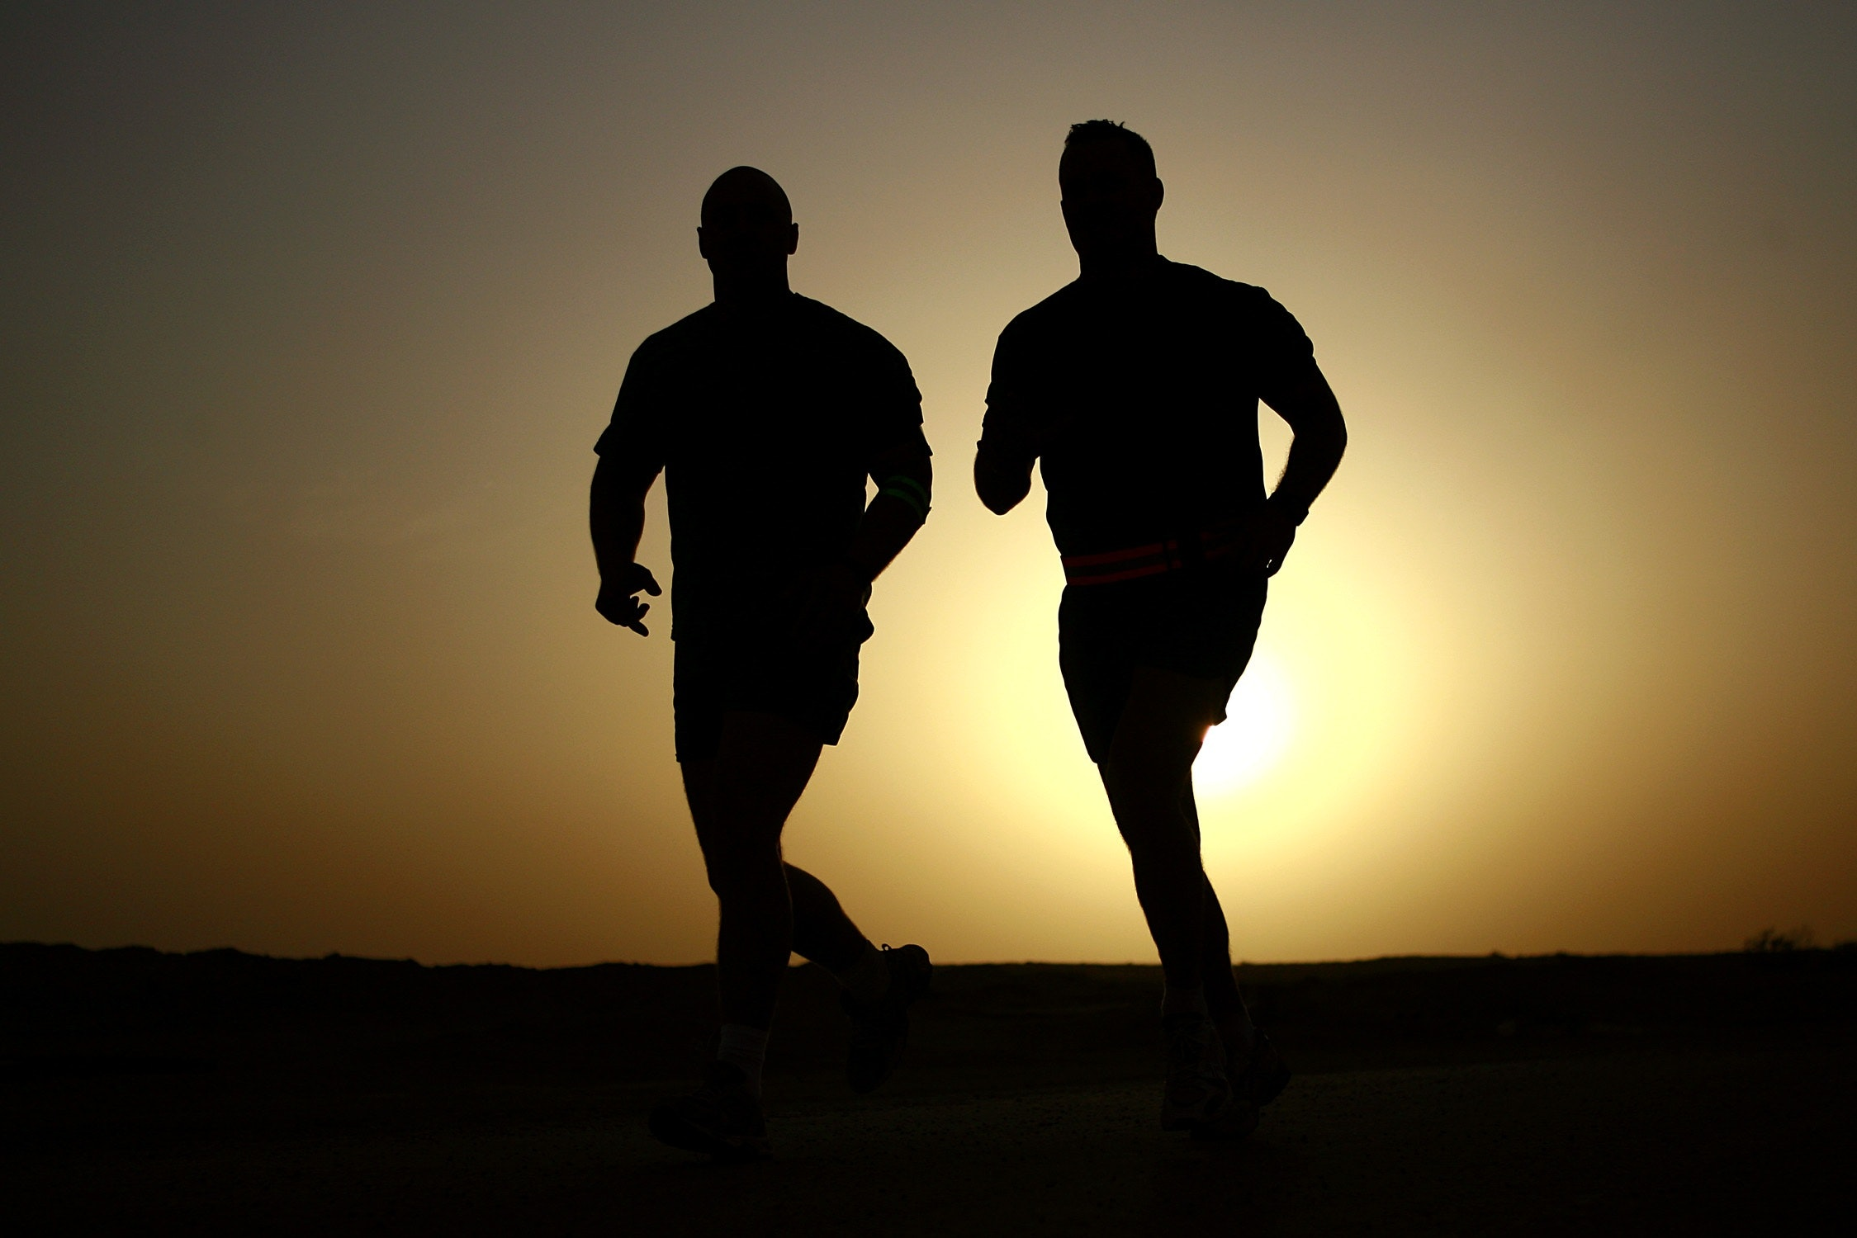
Problem
Runners worldwide are running for themselves, trying to achieve their personal best time.
People with disabilities are not involved in outdoor sports activities and are not visible in society when doing sports.
Weak interaction between target groups.
At the London marathon, a limited number of 10 assisted wheelchair participants can participate, with a maximum of four support personnel helping to push them from Greenwich to Westminster.
(of the four support team members, only two can push the assisted wheelchair at one time)

Slide 3
Implementation Partners
Students
Associations of people with disabilities
Local government
Society
Academia
Business community
Philanthropists

Slide 4
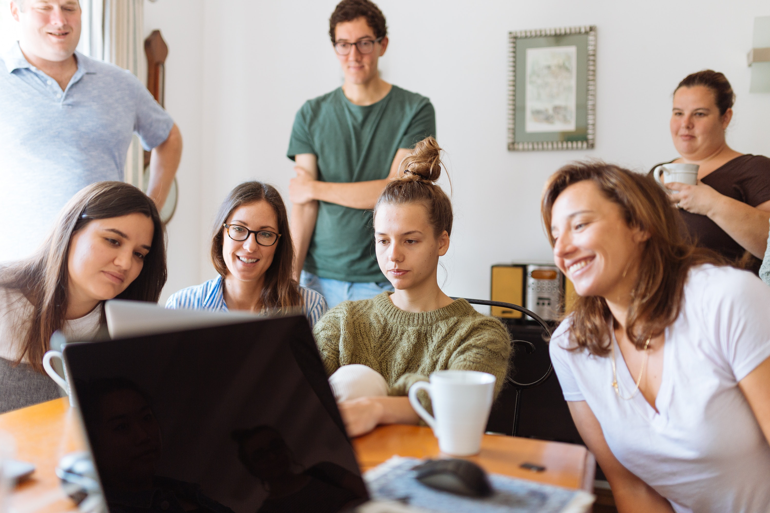
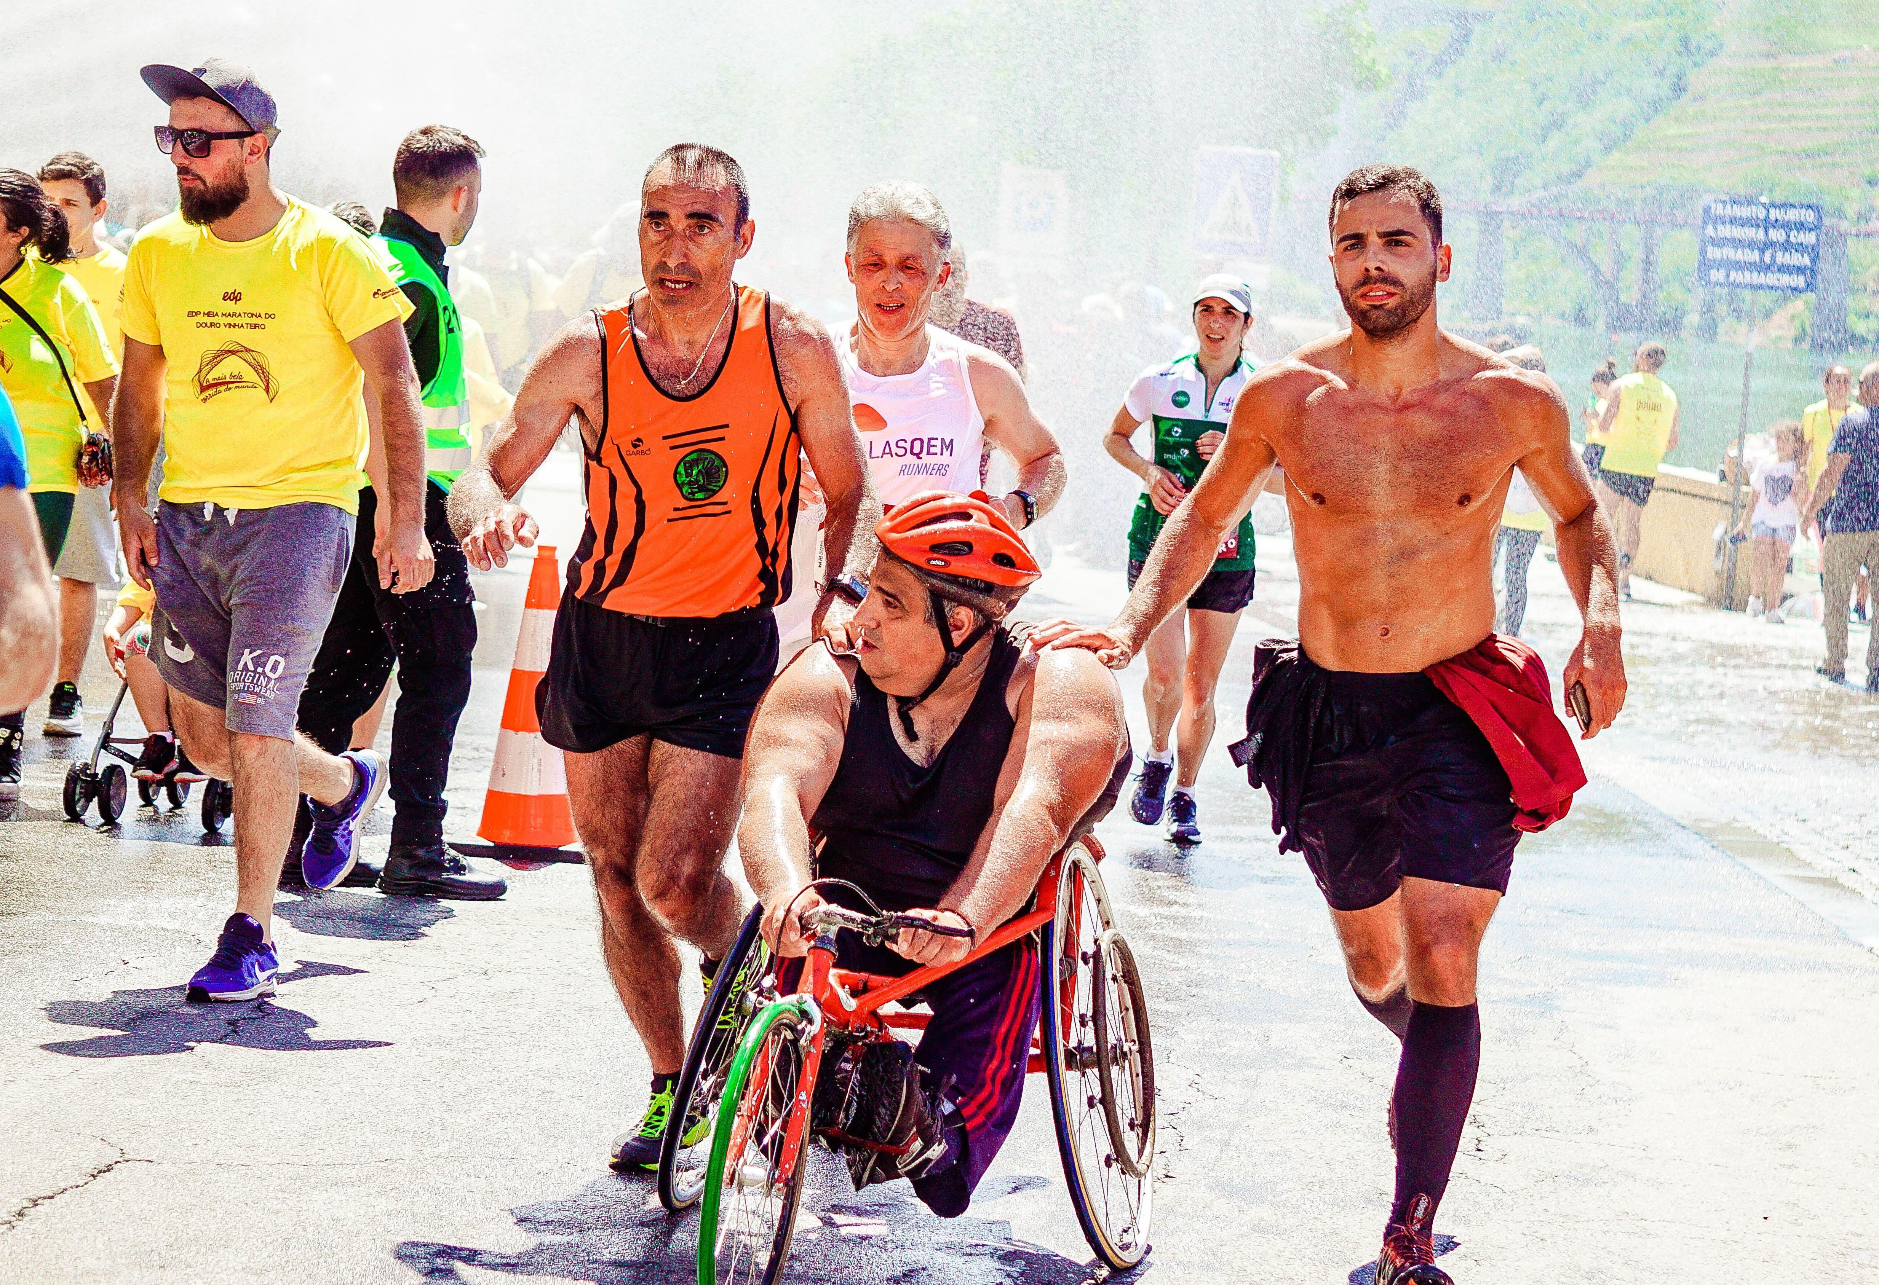
Implementation - Delivery
The Faculty of IT will organize a hackathon to create the best application for the participants.
Faculty of Sport and Physical Education will involve students in participating in race as teammates.
The association of people with disabilities will involve members to race on a 10 km race in Novi Sad.
The organizing committee will be made up of members of the Faculties, students, and people with disabilities.
At the day of of the race volunteers will be engaged to help in organization and implementation.

Slide 5
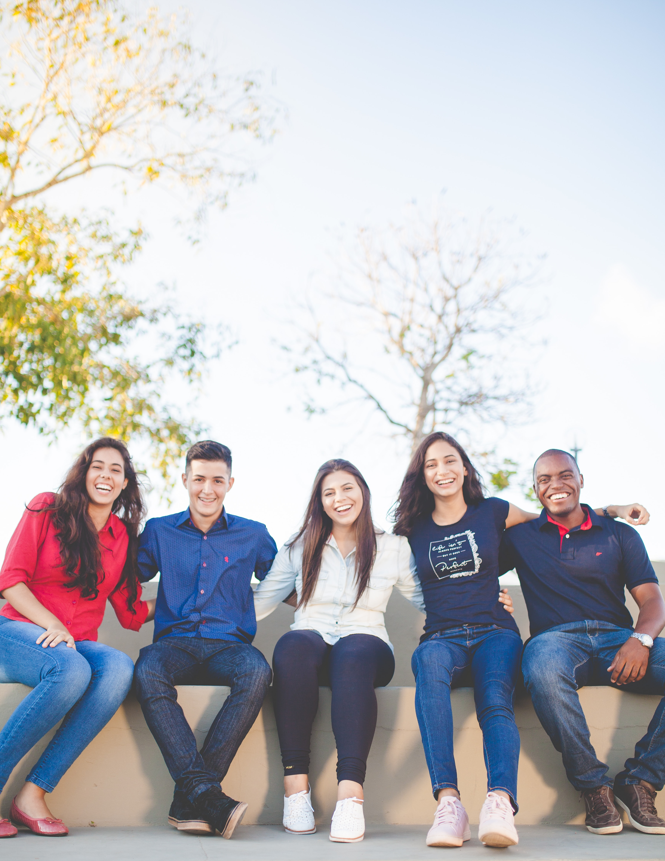
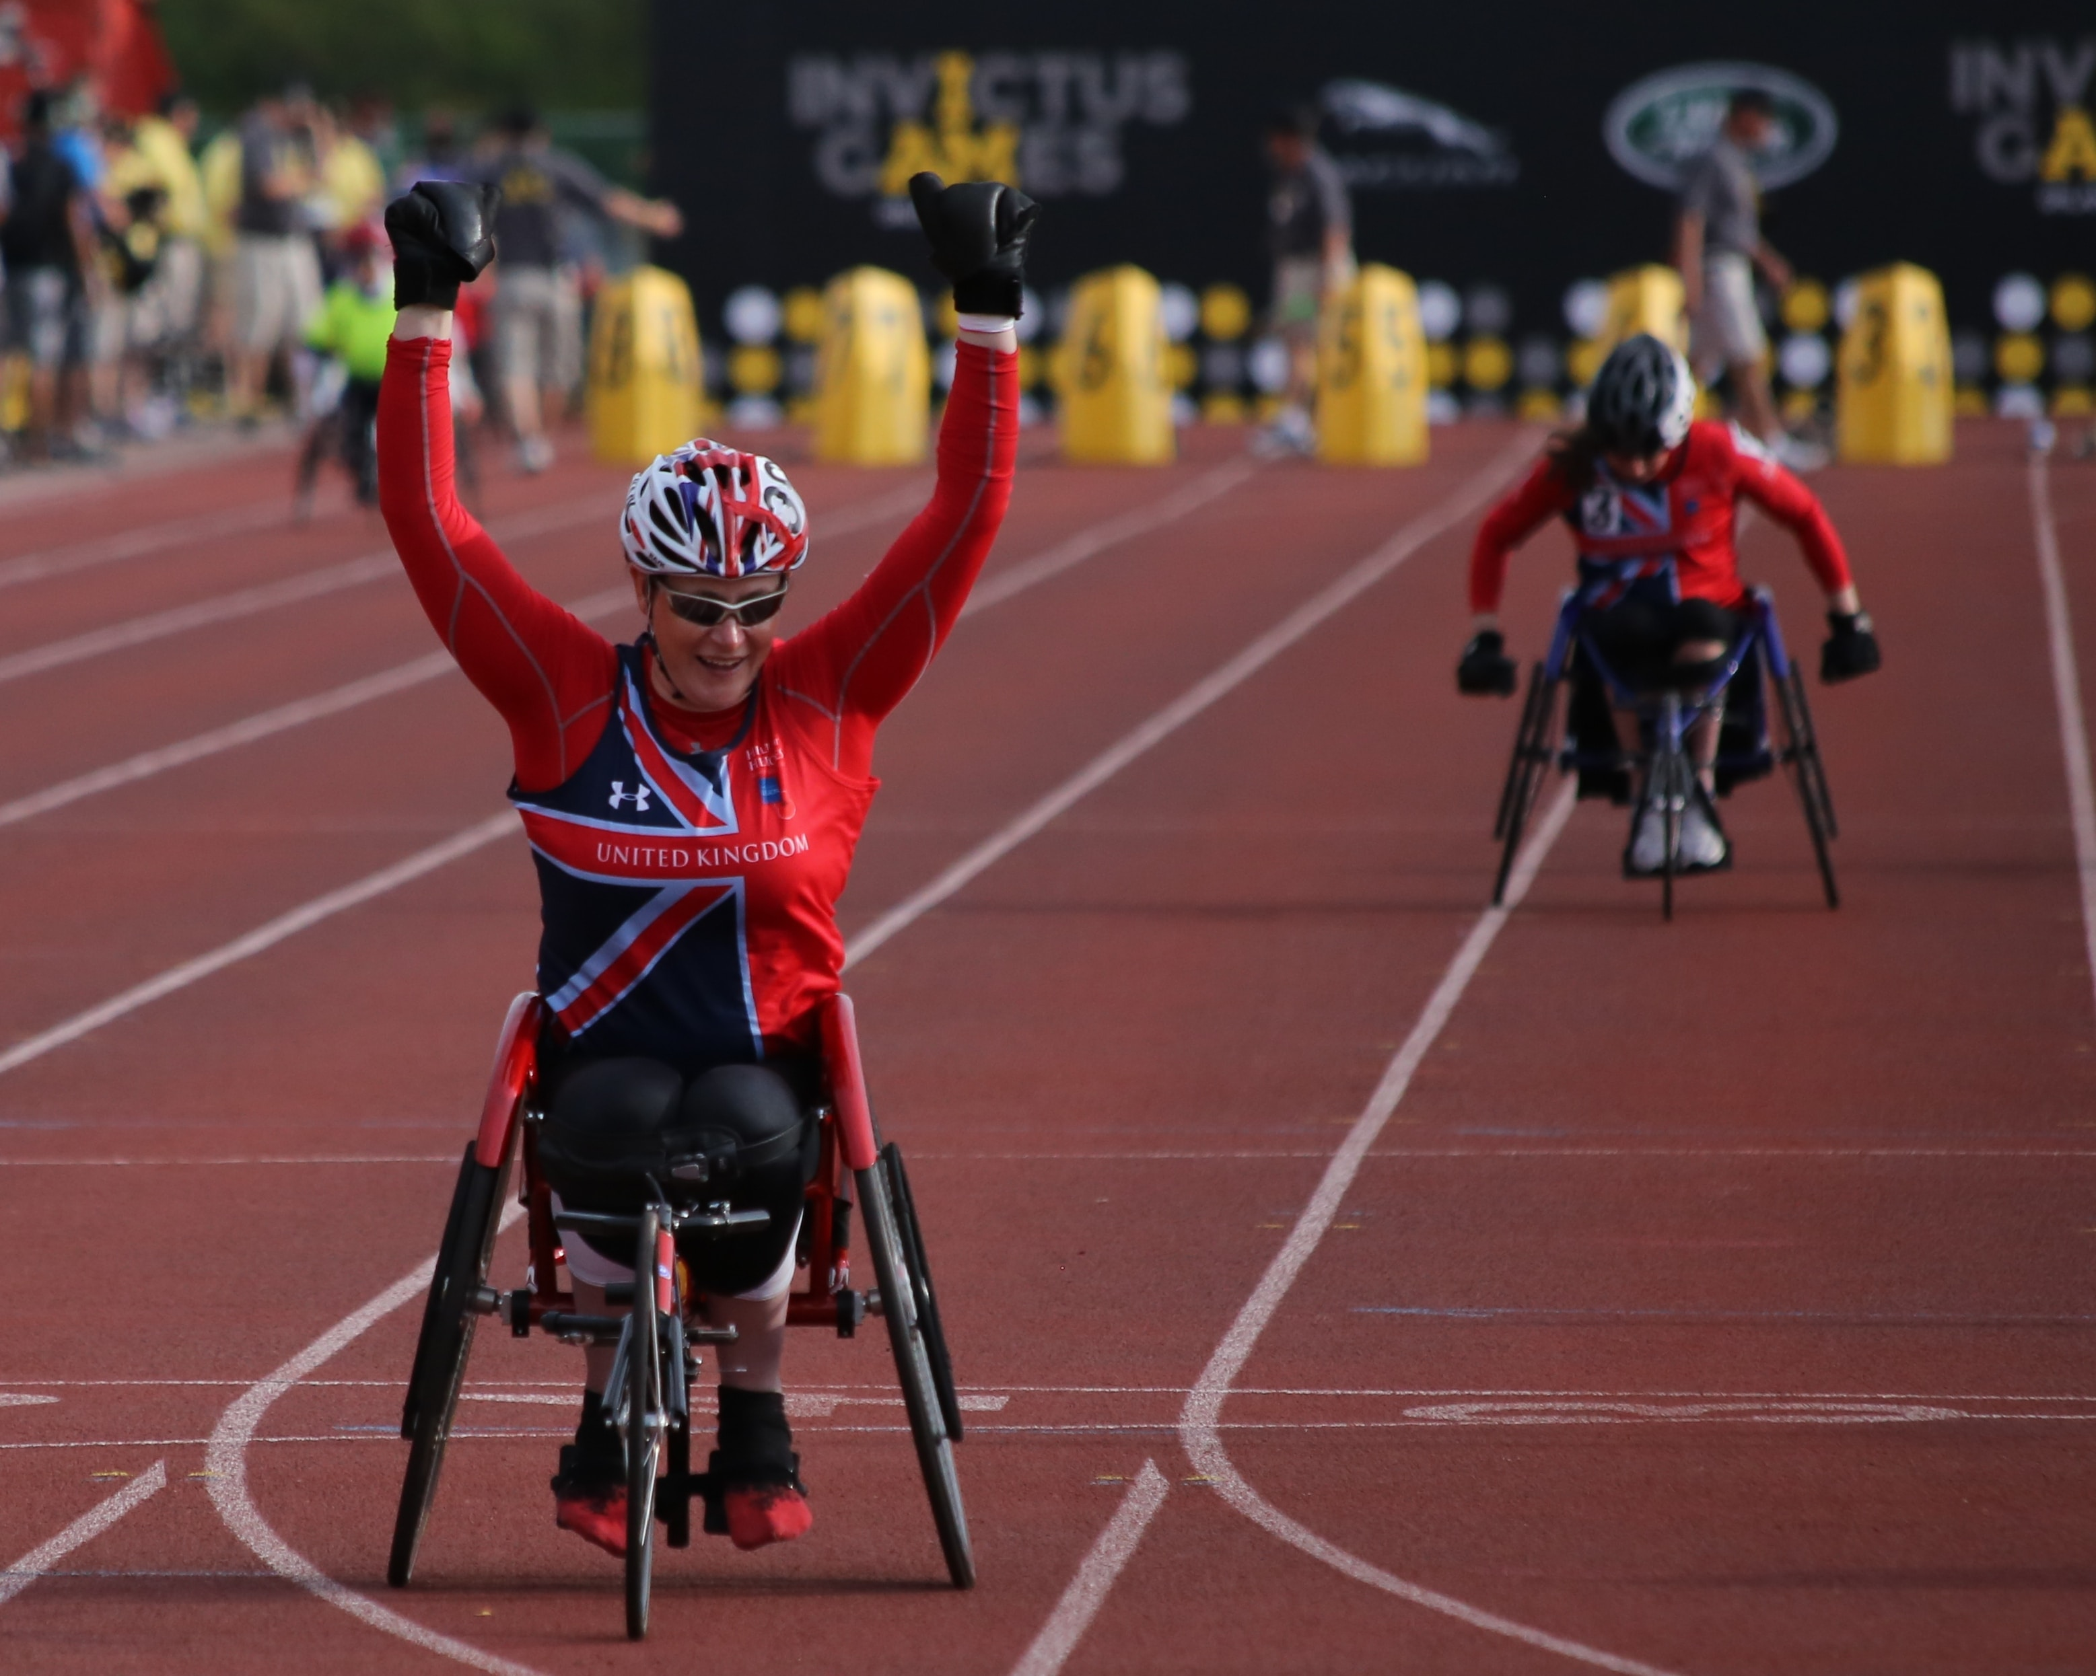
Market – Customer segments
Using the application, participants (students, people in wheelchair and amateur runners) will register and buy BIB numbers.
The application will be used for philanthropic contributions.
Application for sponsorships will be sent to the business community (giving for a sponsor place on a T-Shirts and on the start/finish line).
Faculties will promote social innovation and inclusion during the event.
Students will get practical experience in programming and practice in working together with people with disabilities.

Slide 6
Market – Macroeconomic enviroment
Social changes (increasing diversity and inclusion, shifting consumer preferences, digital conectivity and social media),
Technological change ( digital transformation, e-comerce and mobile comerce, sustainable and clean technologies),
Economic multiplier effect.

Slide 7
Sales + Marketing
Sales:
- Using application
Marketing:
- Association of people with disabilities
- Faculty students associations
- Using running portals
- Distributing invitations for races that are happening before the Novi Sad race
- Social media channels
- Using mass media channels

Slide 8
Social value proposition
The initiative is aimed at promoting inclusivity and breaking barriers for people with disabilities in sports activities
1. Inclusion of People with Disabilities: By actively involving people with disabilities in the race is providing them with an opportunity to showcase their abilities and participate in a mainstream sporting event. This promotes inclusivity and challenges the notion that outdoor sports activities are only for able-bodied individuals.
2. Awareness and Visibility: The race will increase the visibility of people with disabilities in sports, bringing attention to their capabilities and challenging societal stereotypes. By showcasing their participation race is promoting a more inclusive and diverse image of sports.
3. Collaboration and Cross-Disciplinary Efforts: The collaboration between the Faculties of IT and Sport and Physical Education promotes interdisciplinary cooperation. It allows students from different fields to work together towards a common goal, fostering teamwork and encouraging the exchange of knowledge and skills.
4. Practical Experience for Students: Students involved in organizing the event will gain practical experience in programming and application development. This hands-on experience will enhance their skills and provide them with valuable real-world insights.

Slide 9
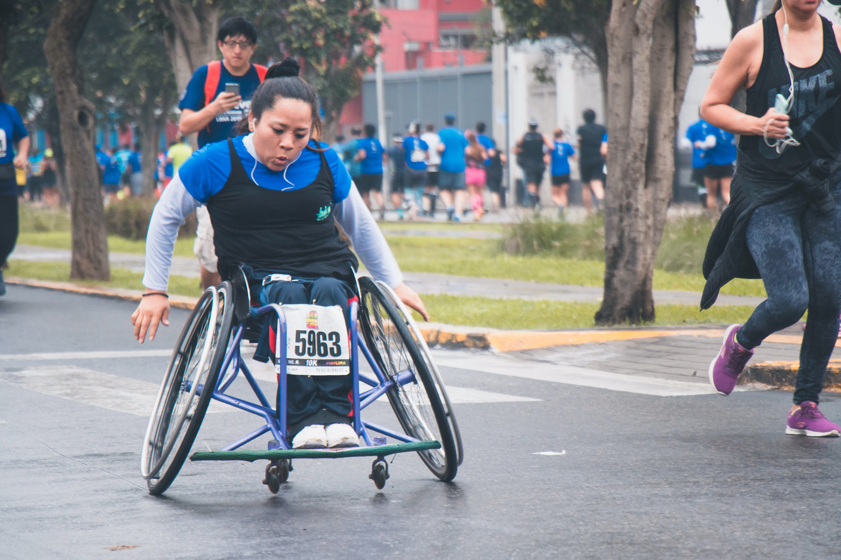
Social value proposition
5. Philanthropic Contributions: This not only promotes a sense of social responsibility but also creates a platform for individuals to contribute to charitable causes.
6. Business Community Engagement: By seeking sponsorships from the business community, organizers are engaging them in supporting the event. This partnership benefits both parties, as businesses gain visibility through branding opportunities while also supporting an inclusive and impactful initiative.
7. Sequential Start for Wheelchair Participants: By starting the race with participants in wheelchairs and then followed by other participants, race is actively highlighting and acknowledging the unique challenges faced by wheelchair users. This symbolic gesture showcases their importance and promotes a more inclusive sporting environment.
Overall, the initiative aims to bridge the gap between different groups, promote inclusivity, raise awareness about the capabilities of people with disabilities, and provide practical learning experiences for students. It strives to make a positive difference by challenging societal norms and fostering a more inclusive and diverse society.

Slide 10
To measure the social impact of the initiative, several key measures can be employed
Participation Rates: Monitor the number of participants, particularly people with disabilities, who register and take part in the race. This measure indicates the level of engagement and inclusivity achieved.
Diversity and Inclusion: Assess the diversity of participants, including the representation of people with disabilities, different age groups, genders, and ethnic backgrounds. This measure ensures that the event is inclusive and reaches a wide range of individuals.
Participant Feedback: Collect feedback from participants, including their experiences, satisfaction levels, and any suggestions for improvement.
Collaboration and Partnerships: Evaluate the level of collaboration and partnerships established between different stakeholders
Philanthropic Contributions: Track the amount of philanthropic contributions raised through the application. This measure reflects the engagement of participants and the broader community in supporting charitable causes.
Media Coverage and Public Awareness: Monitor media coverage and public awareness generated by the event.
Long-Term Impact: Long-term effects of the initiative can be measuered by tracking the continued participation of people with disabilities in sports activities beyond the event.

Slide 11
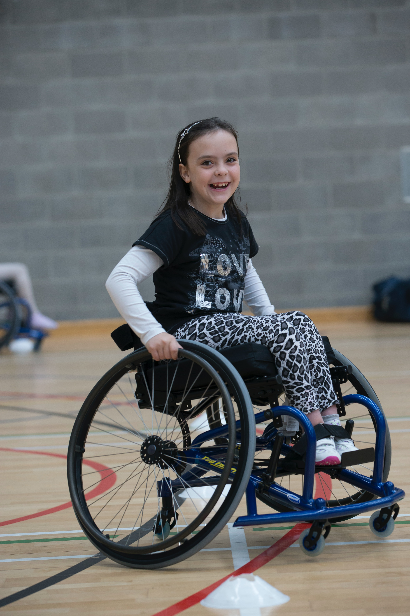
Competitors
Localy Novi Sad already has:
Novosadski marathon,
Noćni marathon,
Fruškogorski marathon,
Trka za dječiji osmeh
Regionaly:
- There is a race every weekend
Shining moments is going to be the first race where participnts in wheelchair will start first and then afther them all other participants. ☺

Slide 12
Costs of delivery
Cost | Amount (EUR)
HR - volonteers | 0
Hackaton and prize fof 1st place | 5000
Info desk | 300
Dressing rooms | 120
Wardrobe | 100
Chip system | 600
Car time display | 50
Start/finish time display | 50
Car | 50
Medals (1000pcs) | 7000
Protective fence barier (60pcs) | 300
T- shirts (1000pcs) | 10000
Fruits for 2 aid stations | 150
Other costs | 2000
Water (sponsors) | 0
Total: | 25720

Slide 13
Revenue
Income | Amount (EUR)
BIB Number | 17000
Sponsor (golden) 1 sponsor | 5000
Sponsor(silver) 2sponsors | 5000
Sponsor (bronze) 3 sponsors | 3000
Sponsors (entrepenurs 50 sponsorships) | 2500
Local goverment | 2500
Donations | 1500
Total | 36500

Slide 14
Surplus will be reinvested in next year edition of the race and financial support of Association of people with disabilities.

Slide 15
Team members:
Brigita Banjac
Marina Gorbatiuc
Marko Boskovic
Ozge Cekirge
Vedrana Ajanovic

