Slide 1
#OnAMissionTogether

Slide 2
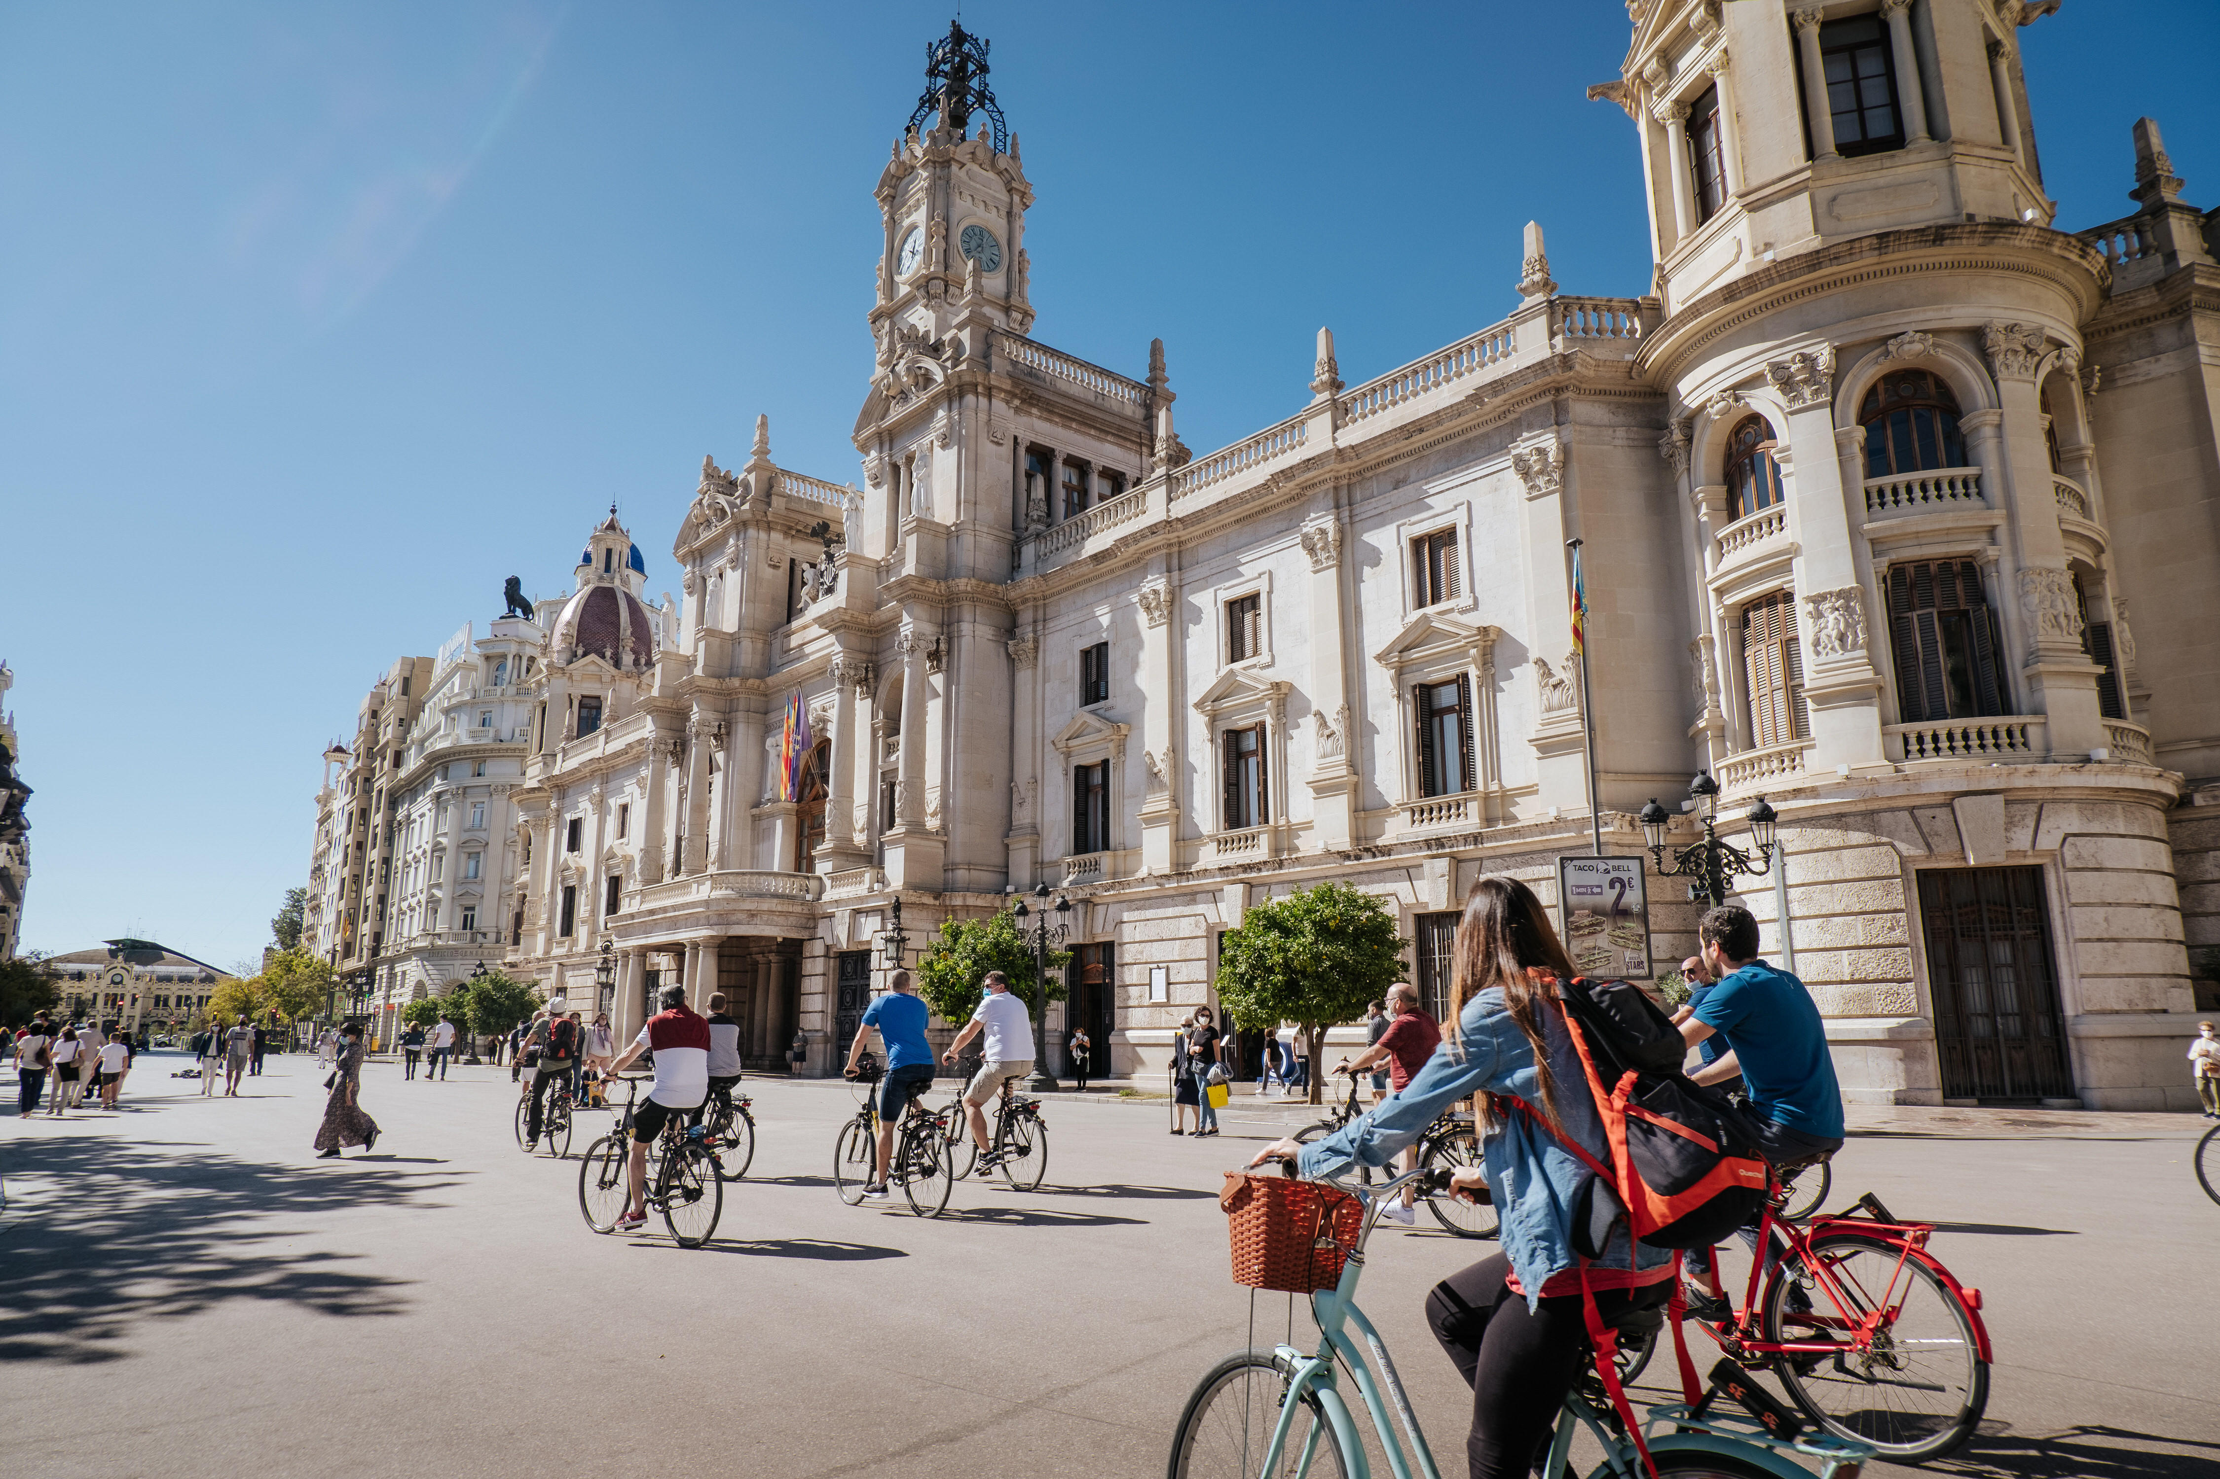

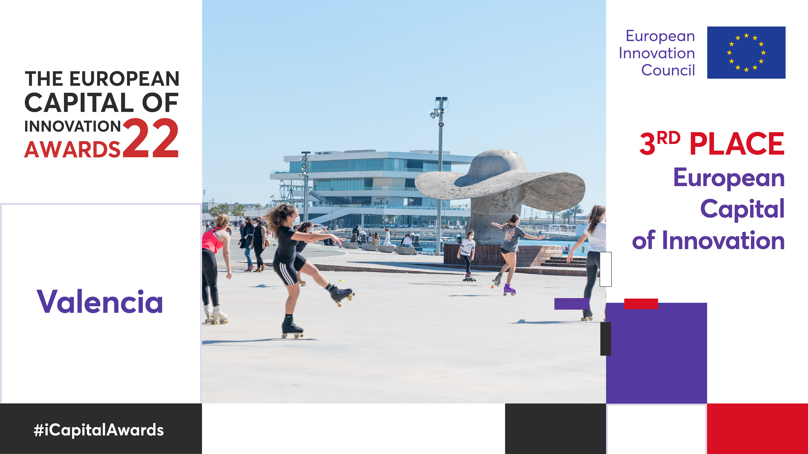
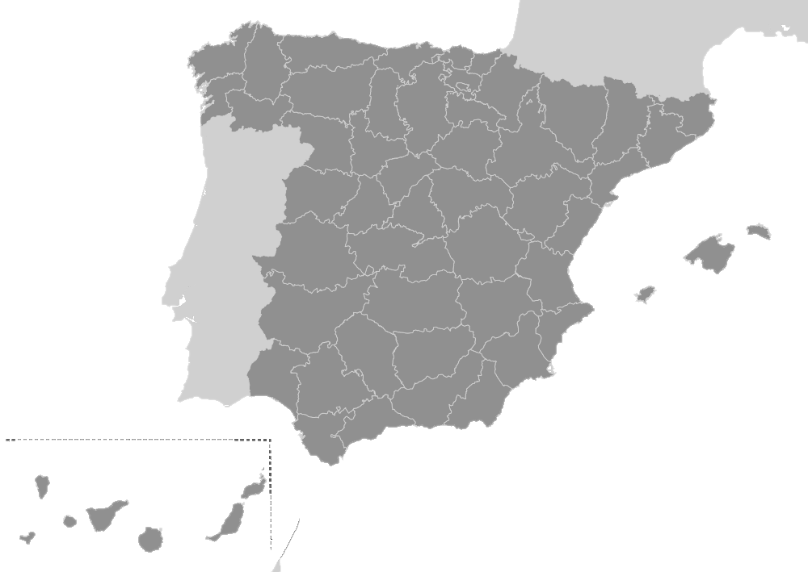
VALÈNCIA

Slide 3


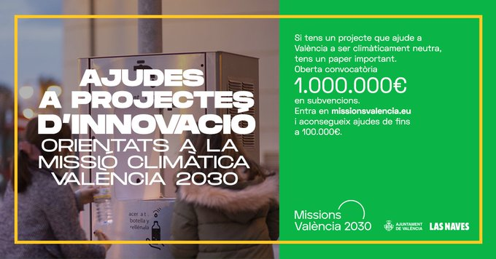




What have we achieved until now?
  OBJECTIVE → To become a climate-neutral city for citizens
  A healthy, sustainable, shared and entrerpreneur city
Urban agenda 2030
+
Innovation strategy
Agreements City-University
1 city mission
Aproved by 98/100 Plenary
Innovation grants & awards to projects and ideas
  1M€ in total / year
  100.000€/Project
  AWARDS: 96.000€ in total
Lighthouse city (2017-2023)
  17 EU projects
  Coordination of 2 projects
  268 partners, 28 countries
  5,82 M€

Slide 4
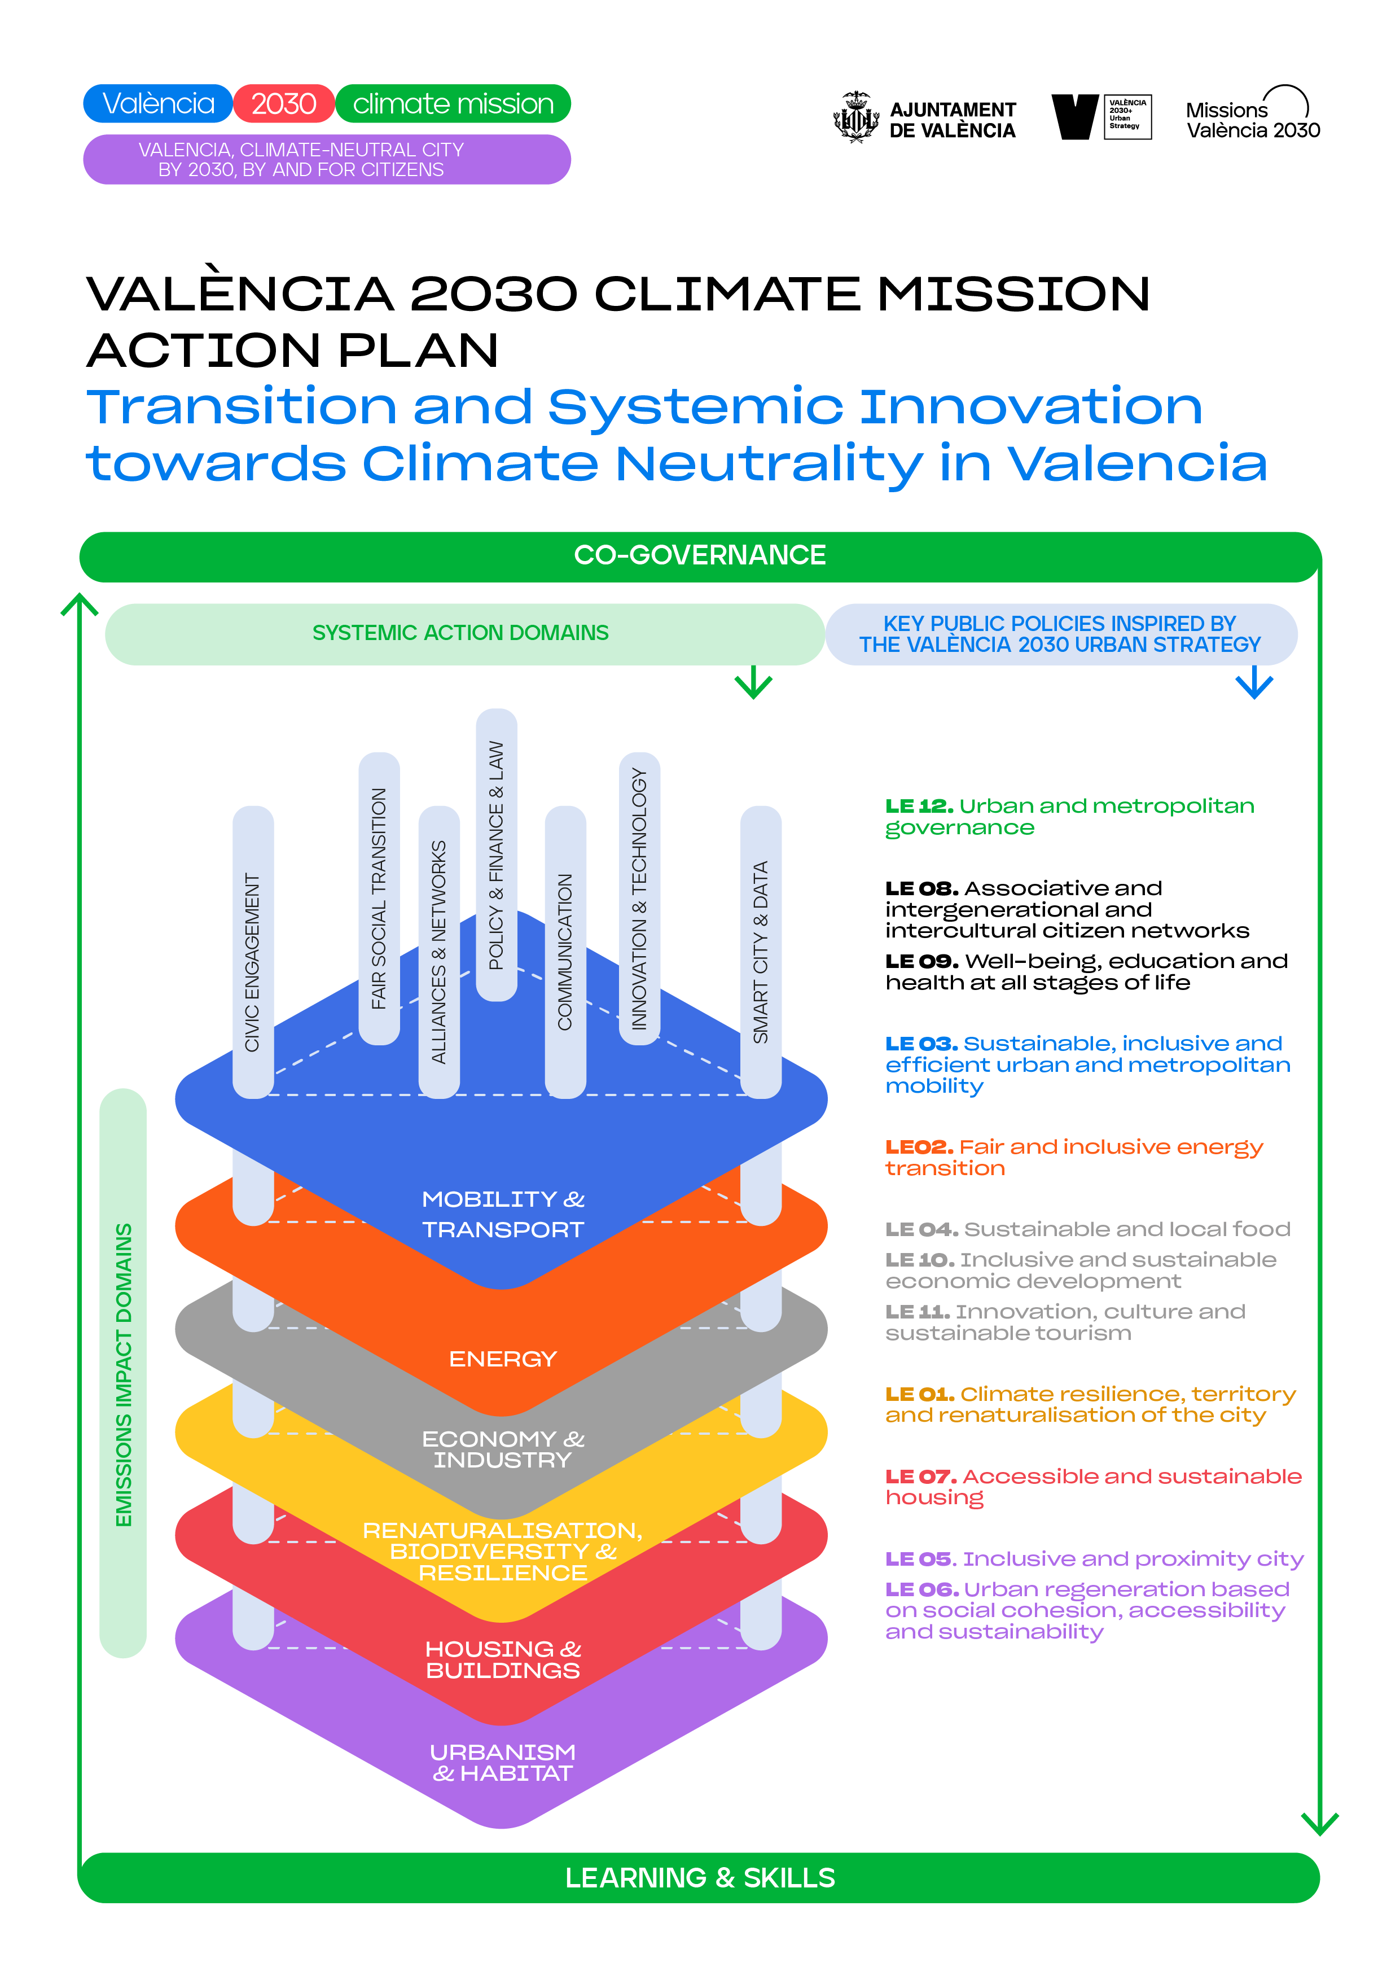
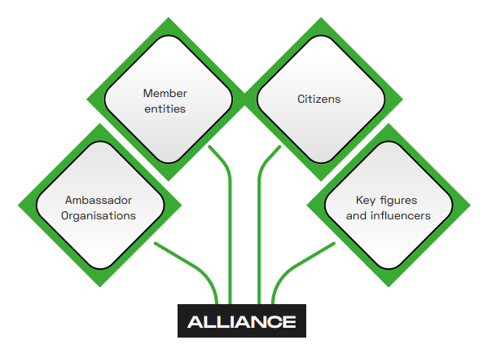
Impacts on València Climate Missions 2030
HOW? → re-orientation of innovation instruments + new ones
→ co-creation with 5-hélix innovation ecosystem
→ Public-private Partnership Initiatives
2 Living Labs
5-helix + real compromises
La Marina Living Lab
UPV Living Lab
Innovation Public Procurement
  305 public unmet needs identified in total
  8 challenges
  155 proposals received
  99 organizations

Slide 5
www.missionsvalencia.eu
info@missionsvalencia.eu
Anna Melchor
LAS NAVES
anna.melchor@lasnaves.com

